Slide 1

AFK Engine
by Pack Mules
Domenic Pullar-Khan
Kenneth Mak

Slide 2
AFK Engine
A 2D engine
Focuses mostly on collision and physics
Component structure similar to Unity
GameObject
Transforms
Rigidbody

Slide 3
Golf Greens
A Demo of our engine with a mini-golf game
Currently a 2-Player game

Slide 4
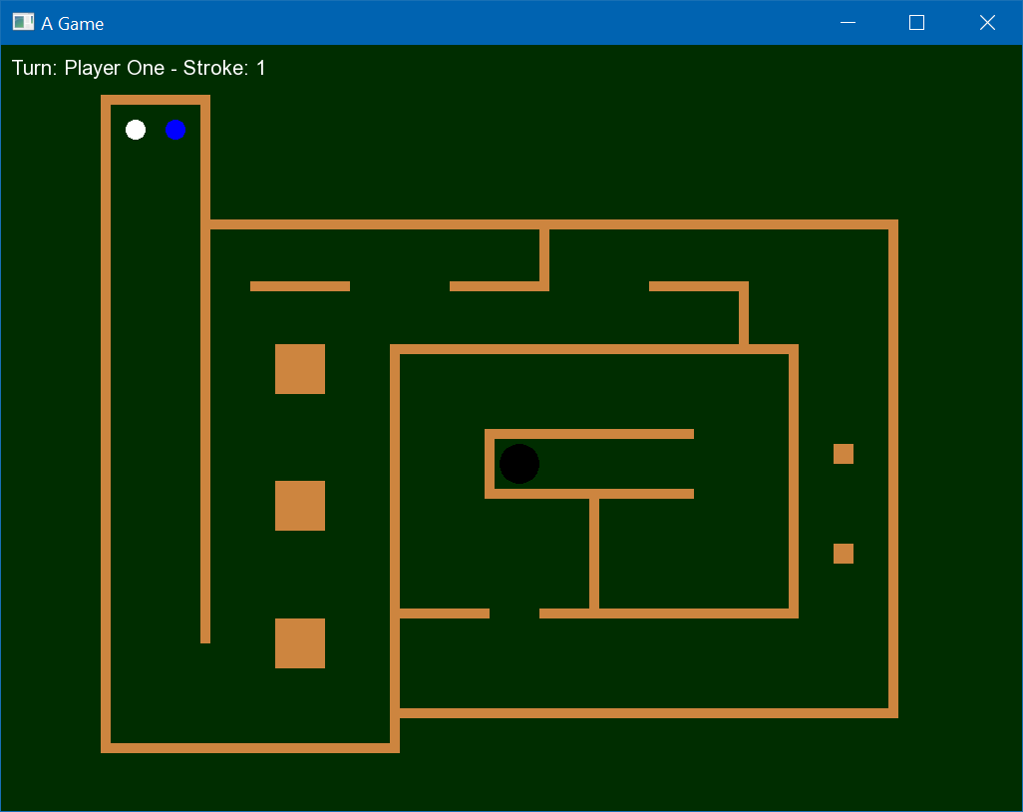

Slide 5
Golf Greens
Balls can be hit while in motion
Balls will collide with other balls

Slide 6
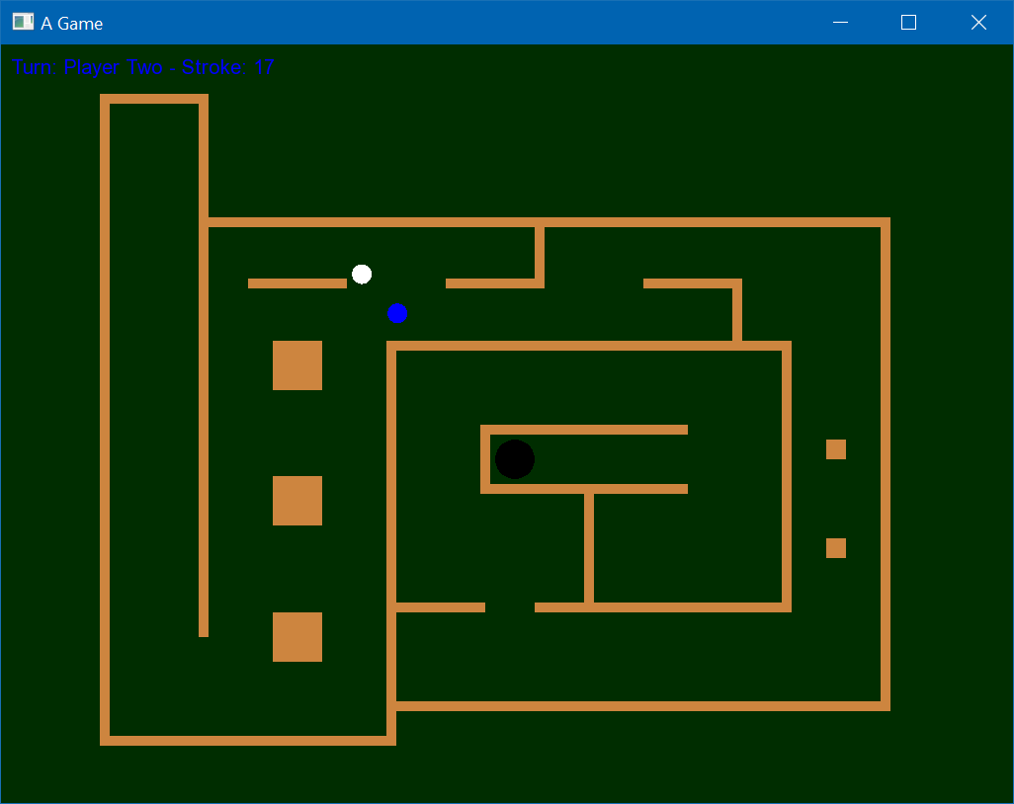

Slide 7
Advantages
Physics Collision
Circle & Rectangle Shapes
Audio Implementation
GameObject structure easy to understand

Slide 8
Disadvantages
No XML/JSON, objects are hard coded
Only circles & rectangles

Slide 9
What could be improved next?
Clean up the code
Implement XML/JSON loading for better scene building

Slide 10
What else can this engine be used for?
Anything with simple collisions with shapes of rectangles or circles
Most simple 2D Games
Pong
Brick Breaker
Pool
Possibility of platformers

